Slide 1
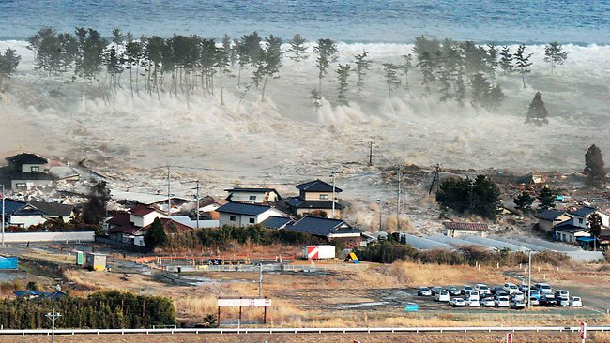
Earthquake Forecasting and Risk
Image Courtesy NHK
John B Rundle
Distinguished Professor, University of California, Davis (www.ucdavis.edu)
External Professor, Santa Fe Institute (www.santafe.edu)
Chairman, Open Hazards Group (www.openhazards.com)

Slide 2
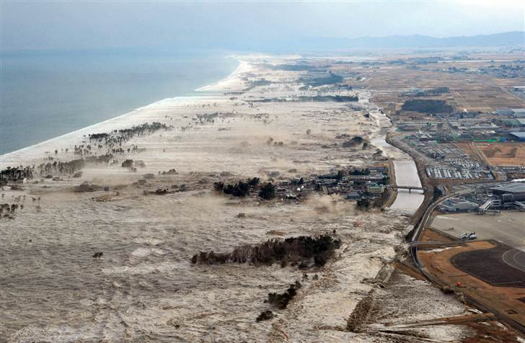
Image Courtesy NHK

Slide 3
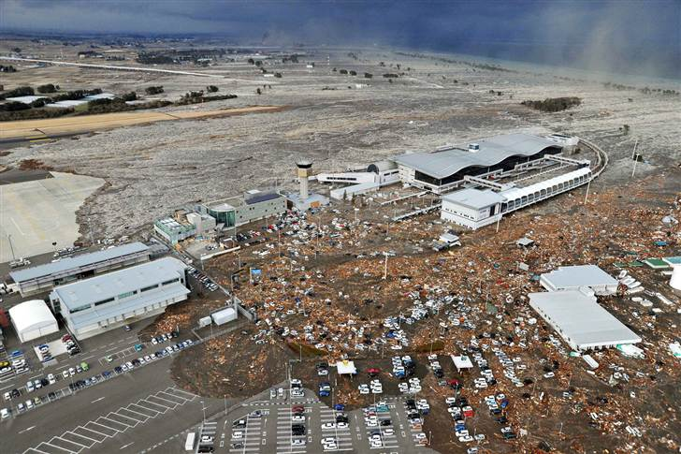
Image Courtesy NHK

Slide 4
Topics
Earthquakes and other Catastrophes
Risk Management as Currently Practiced
Forecasting
Risk Management

Slide 5
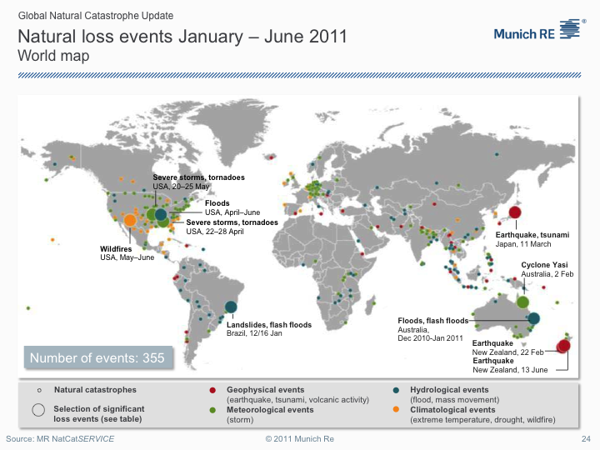
Impacts
Loss Trends (Munich Re, 2011)

Slide 6
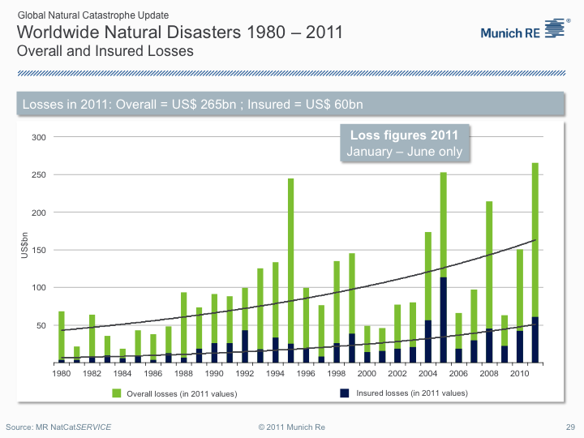
Does not include Hurricane Irene or the M5.8 Virginia earthquake

Slide 7
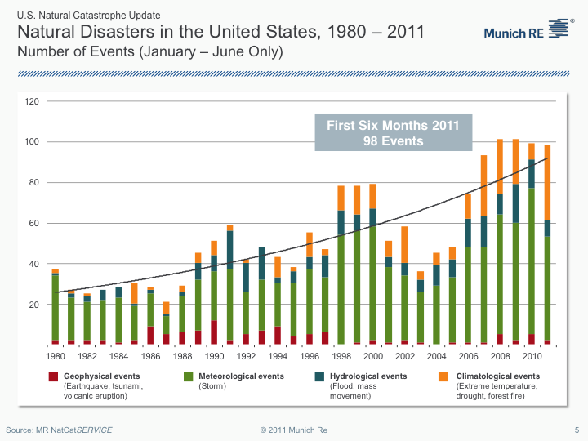
Does not include Hurricane Irene or the M5.8 Virginia earthquake

Slide 8
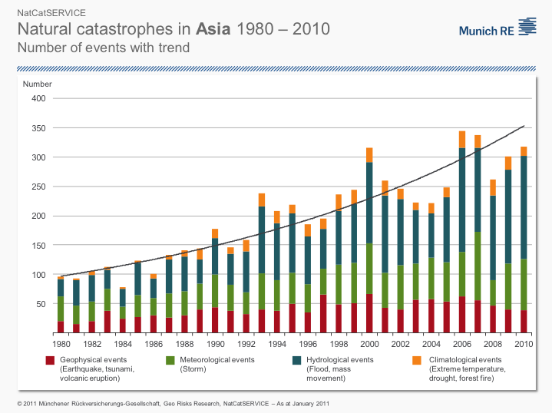

Slide 9
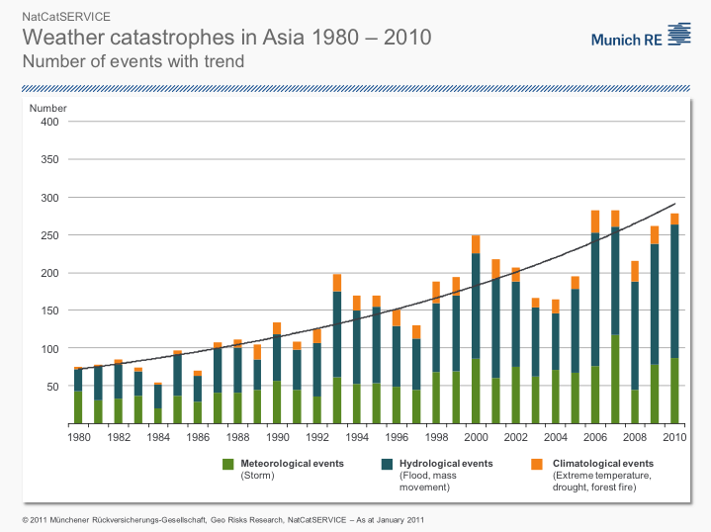

Slide 10
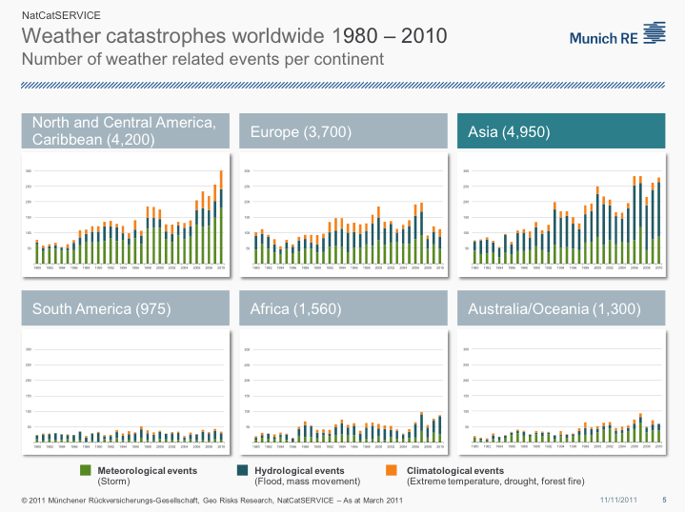

Slide 11
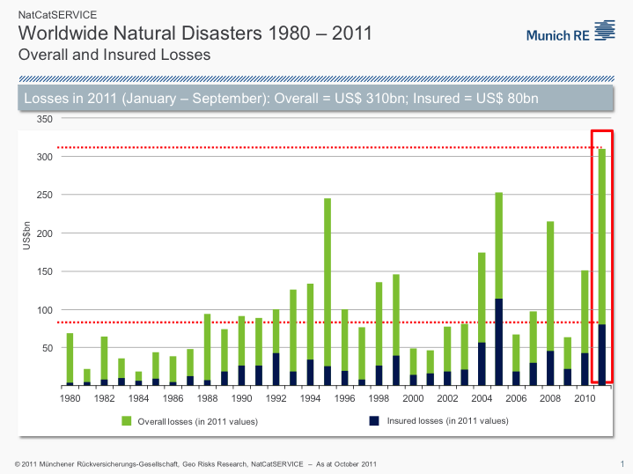

Slide 12
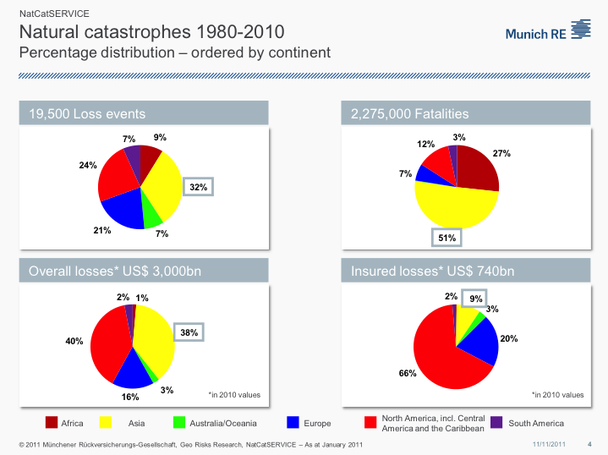

Slide 13
Risk Management
Currently, risk management is done by big corporations for big corporations
Modern social networking technology together with web-based information and tools has enabled a new era of Personal Risk Management

Slide 14
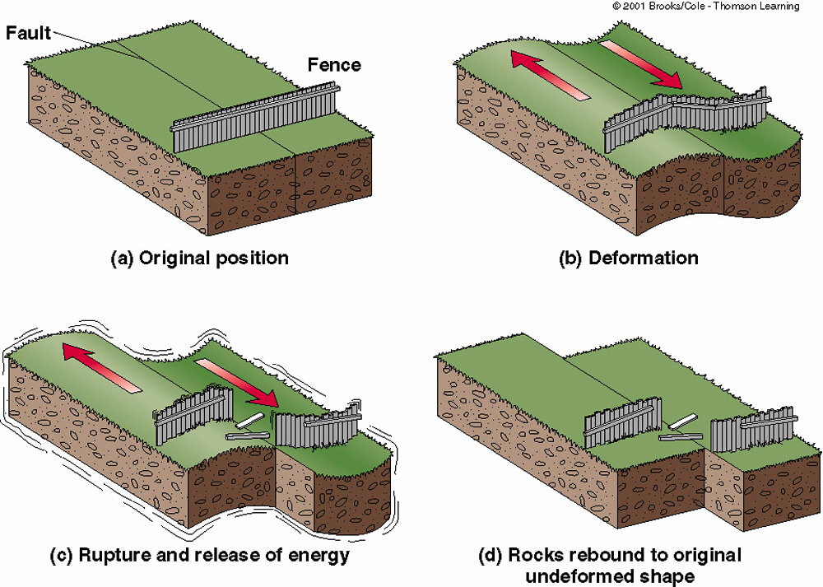
Earthquake Cycle
Deficit in fault slip accumulates from large scale plate tectonic motions

Slide 15
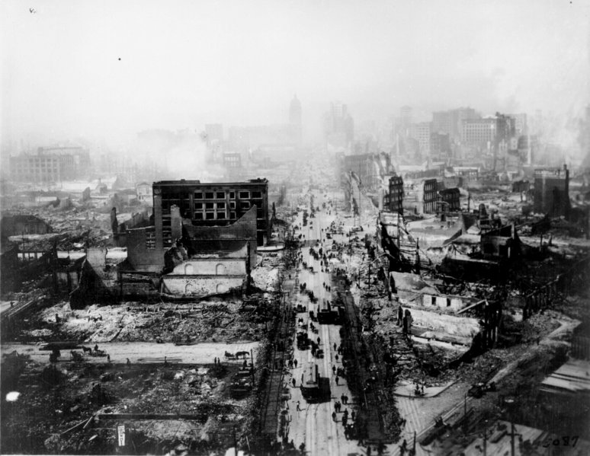
1906 San Francisco Earthquake M~8

Slide 16
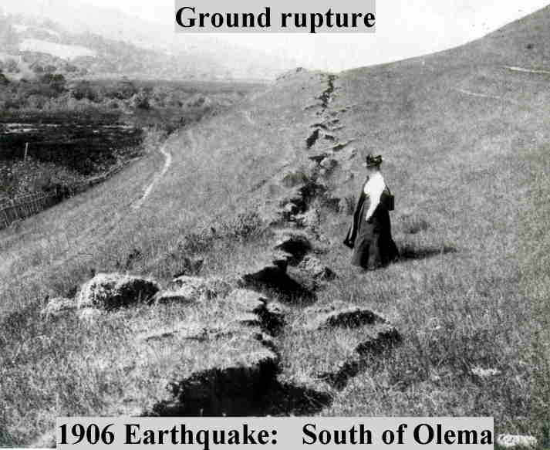
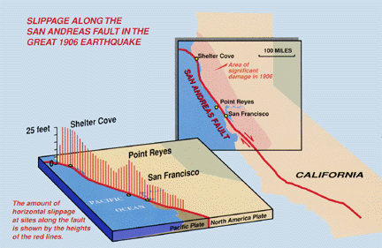
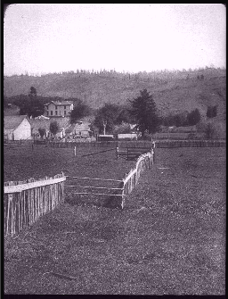
The Great 1906 San Francisco Earthquake Extended for ~ 350 km Along the San Andreas Fault in Northern California.
Horizontal offsets of as much as 8 meters was observed.
Wayne Thatcher, US Geological Survey

Slide 17
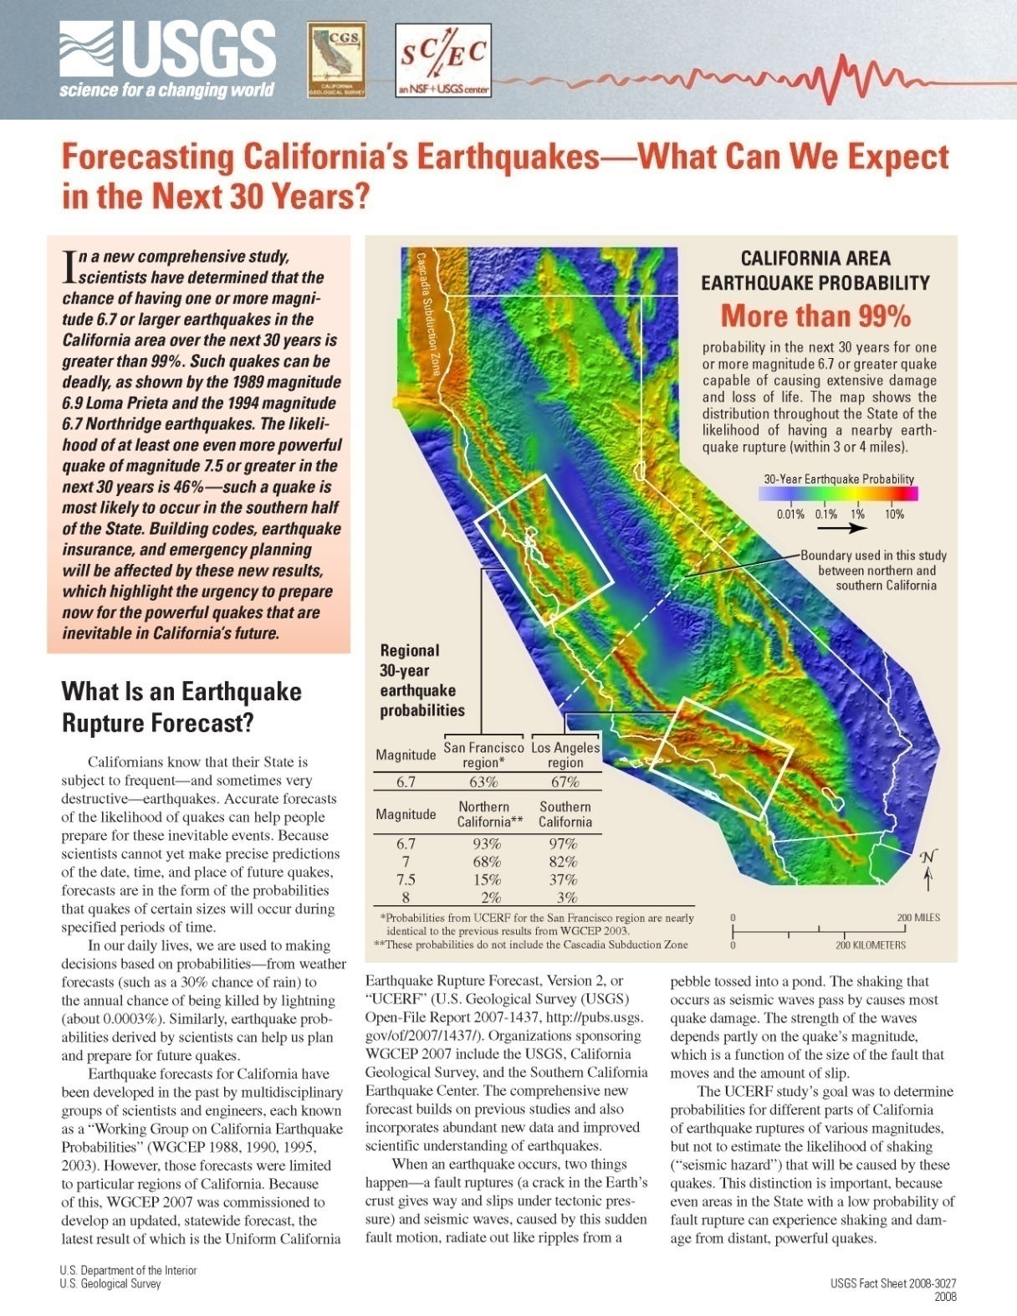
The Current Official California Forecast
Working Group on California Earthquake Probabilities 2007
Method requires many tens of scientists over ~4 years to produce a single 30 year forecast.
Approx. 2000 model parameters whose values are set using “expert opinion”.
Method cannot be automated (because it uses expert opinion) so the forecast cannot be backtested.

Slide 18
Financial Strategies for Dealing with Risk: Example
Hypothetical $75 Million Single-Peril Earthquake Cat Bond
If no earthquake occurs, cat bond returns principal + LIBOR + risk premium after 2 years
LEP Curve
Calculated by Modeling Company
100%
Fraction of Principal Remainng (%)
Annual Loss Exceedance Probability
$50 Million
$75 Million
Loss ($)
Indemnity Bond
London Interbank Offered Rate (LIBOR) ~ 5% / yr
Risk Premium ~ 5% / yr
Bond Multiple = 5% / 1% = 5
1.0%
Fat Tail (Power Law)
0.25%
$50 Million
Attachment Value
$75 Million
Exhaustion Value
Loss ($)

Slide 19
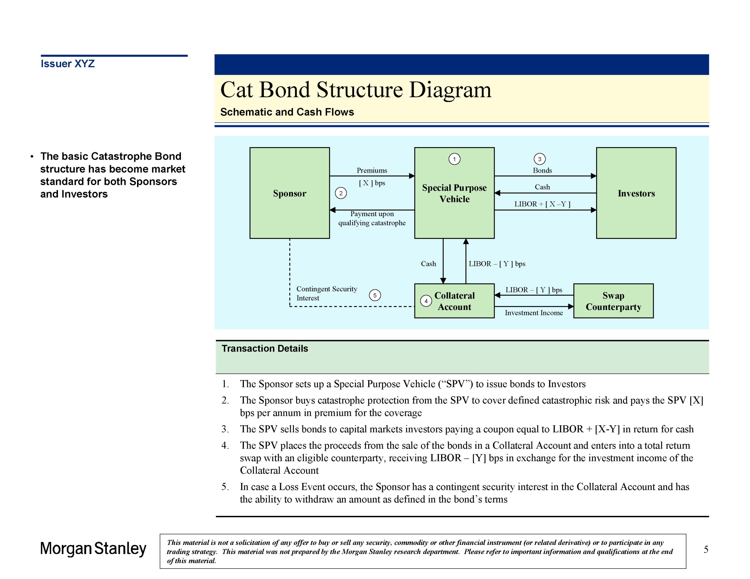

Securitized Catastrophe Bond Structure

Slide 20
Advanced Earthquake Forecast Operational Earthquake Forecasting JBR et al., Physical Review E, in press (2012)
Uses ANSS global digital catalog data
Updated in real time
Backtested and optimized (no expert opinion)
Accounts for correlations of earthquake interactions
Probabilities can change rapidly in time

Slide 21
A New Data Driven Earthquake Forecast Operational Earthquake Forecasting
Natural Time Weibull (NTW)
ANSS global digital catalog data
Uses a standard probability model (Weibull)
Select best parameters based on backtesting
Accounts for correlations of earthquake interactions
Probabilities increase with:
- Increases in small earthquake rate
- Time since the last large earthquake
Probabilities of another large earthquake decrease just after the most recent event (but not to zero!)

Slide 22
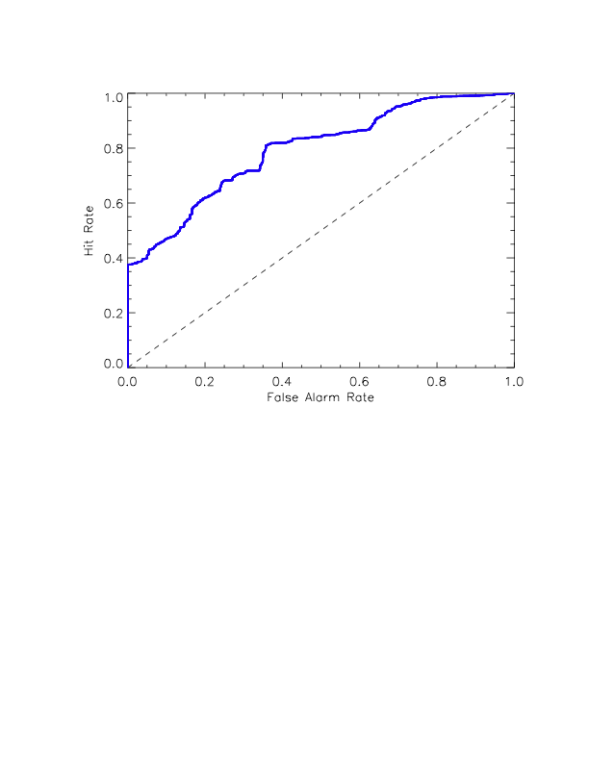
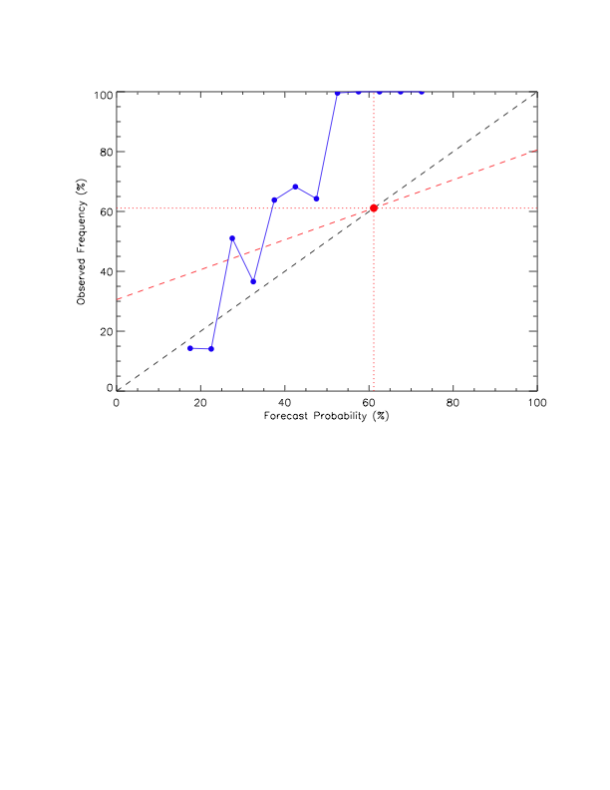
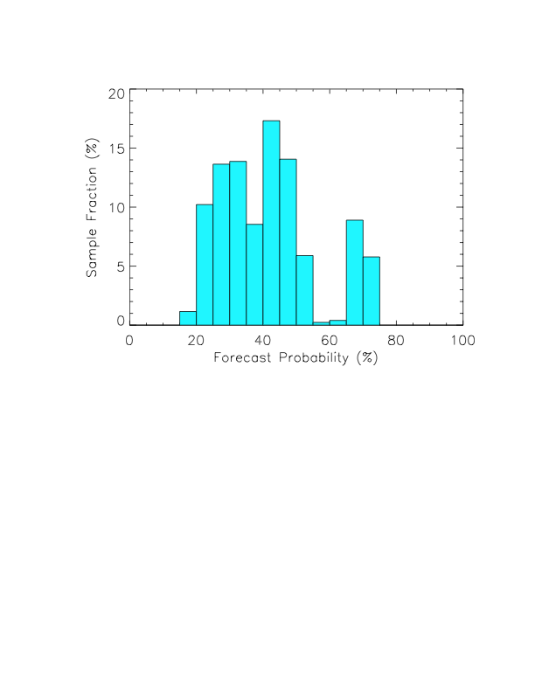
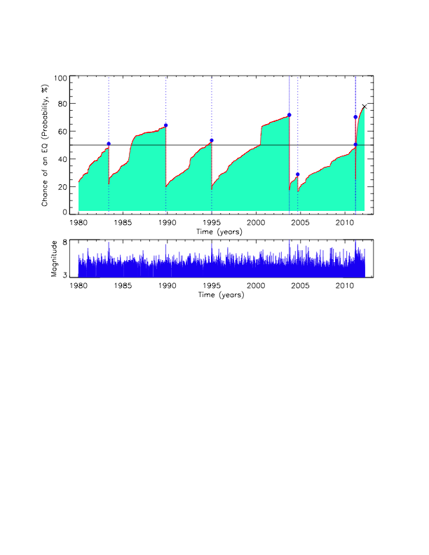
Optimized 48 month Japan forecast:
Probabilities (%) vs. Time for Magnitude ≥ 7.25
Japan EQ Forecast
Advanced Technology
(Open Hazards Group)
Optimal forecasts via backtesting, using
common validation and verification testing procedures.
Forecast Date: 2012/03/16
Scatter Plot
1980-present
Observed Frequency vs. Computed Probability
Temporal Receiver Operating Characteristic
1980-present

Slide 23
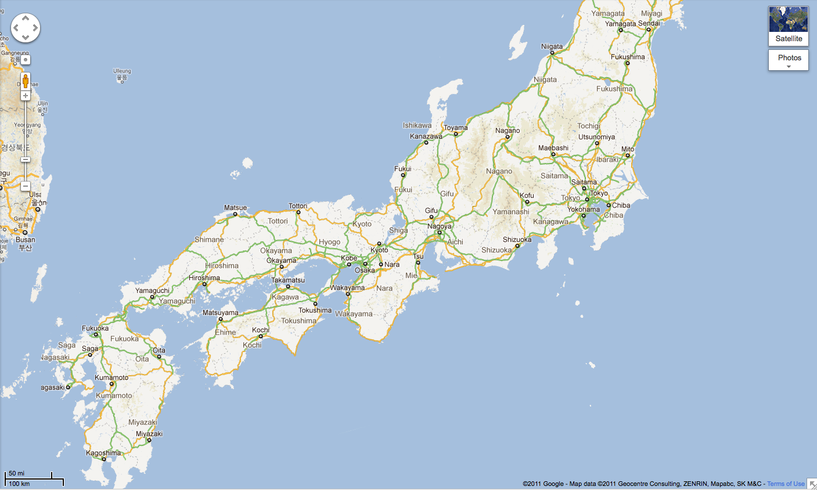
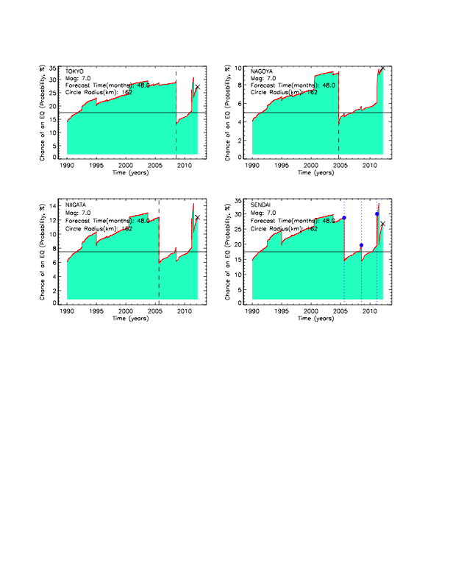
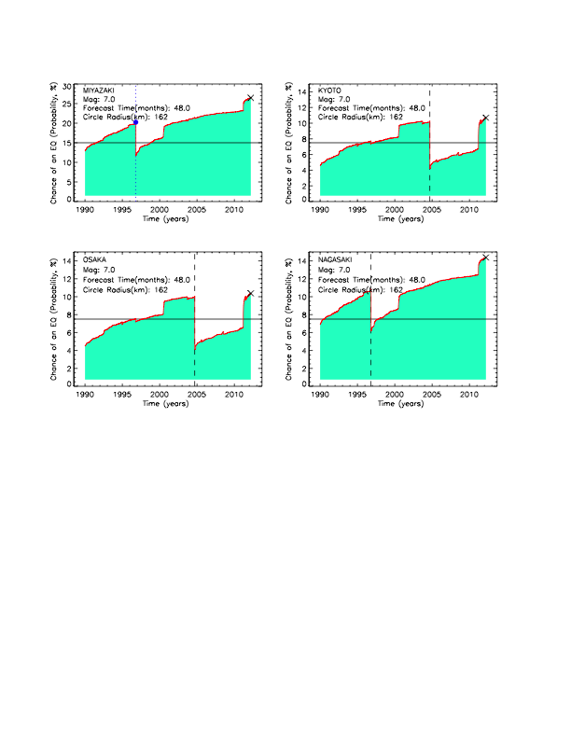
Earthquake Forecasts (Probability in %) for Eight Cities in Japan
Probability of Magnitude ≥ 7 -- Within 4 Years from 3/16/2012 and Within 100 miles
13%
Niigata
81 KM: 1.6%
161 KM: 4.0%
242 KM: 9.7%
11%
27%
Sendai
81 KM: 1.6%
161 KM: 9.2%
242 KM: 20.9%
Kyoto
81 KM: 1.2%
161 KM: 3.5%
242 KM: 6.9%
15%
Nagasaki
81 KM: 1.2%
161 KM: 5.3%
242 KM: 9.8%
28%
Tokyo
81 KM: 1.0%
161 KM: 8.6%
242 KM: 22.6%
10%
Nagoya
81 KM: 0.7%
161 KM: 3.2%
242 KM: 13.3%
11%
27%
Osaka
81 KM: 2.0%
161 KM: 3.4%
242 KM: 7.0%
Miyazaki
81 KM: 5.2%
161 KM: 10.1%
242 KM: 14.5%

Slide 24
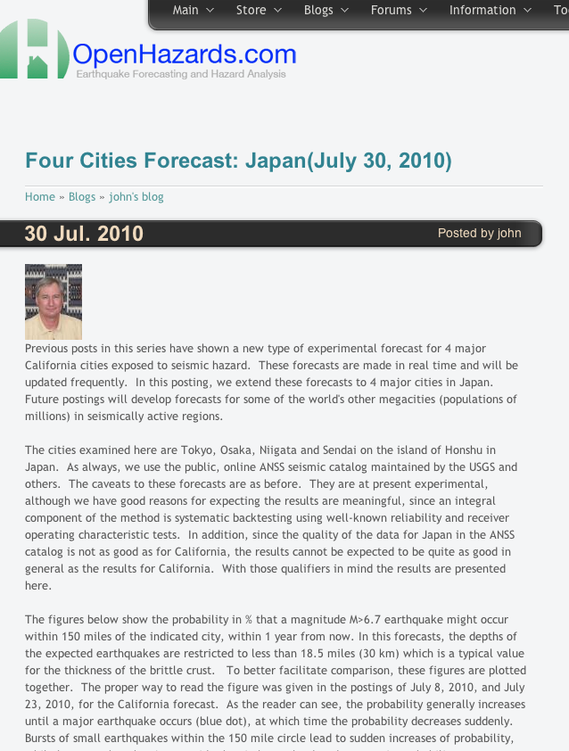
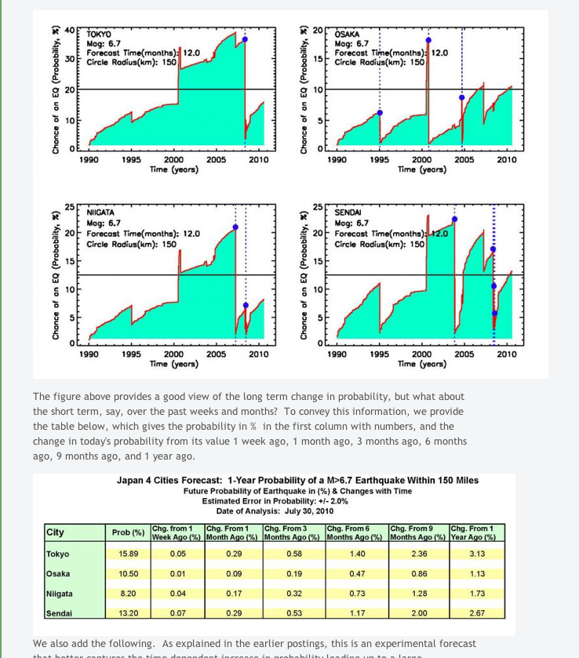
Japan 4 Cities Forecast
Probability of M≥6.7, Within 12 Months, Distance ≤ 150 miles
Blog posted July 30, 2010
Tokyo:
16%
Osaka:
10%
Niigata:
8%
Sendai:
13%

Slide 25
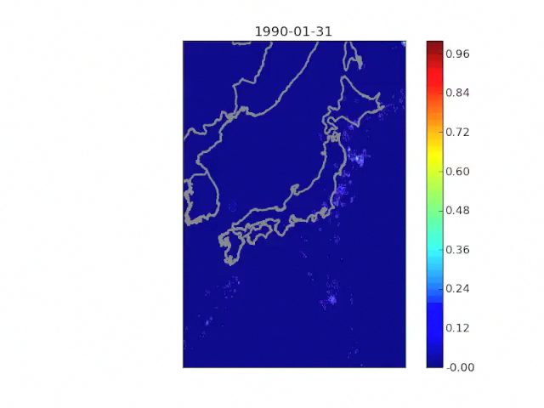
M9.1 Great Tohoku
Earthquake
March 11, 2011
Movie produced on March 8, 2011
by W. Graves and J.R. Holliday
Probability of M>6 Earthquake within 1 Year of Date

Slide 26
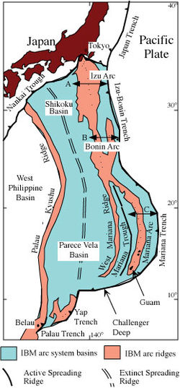
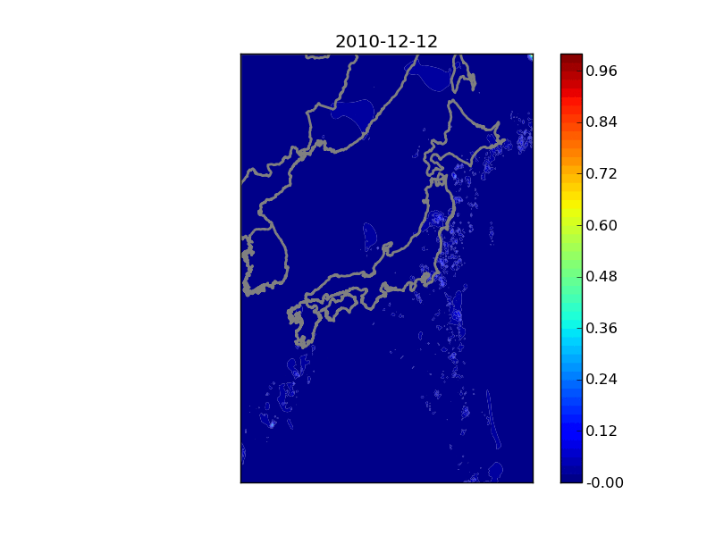
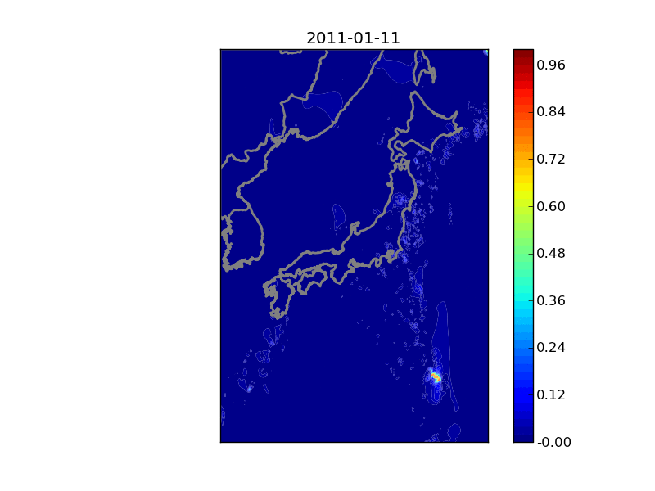

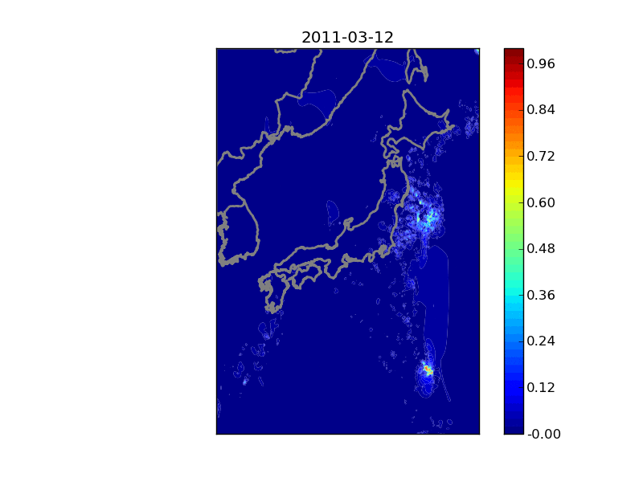
Great Tohoku Earthquake:
Could it have been triggered by
another earthquake?
Trigger event may have been a M7.4 earthquake that occurred on December 21, 2010, 100 km east of the Ogasawara Islands, on the Izu-Bonin-Mariana trench (e.g., east of Iwo-Jima and Chichi-Jima, Japan

Slide 27

Izu-Bonin-Mariana
Arc Forecast for the Next Year from 2012/01/06
Risk of another great earthquake and tsunami?

Slide 28
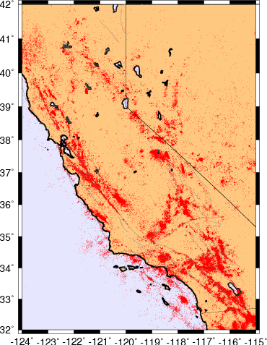
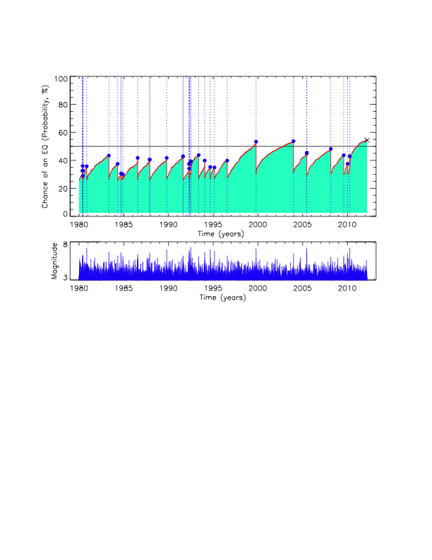
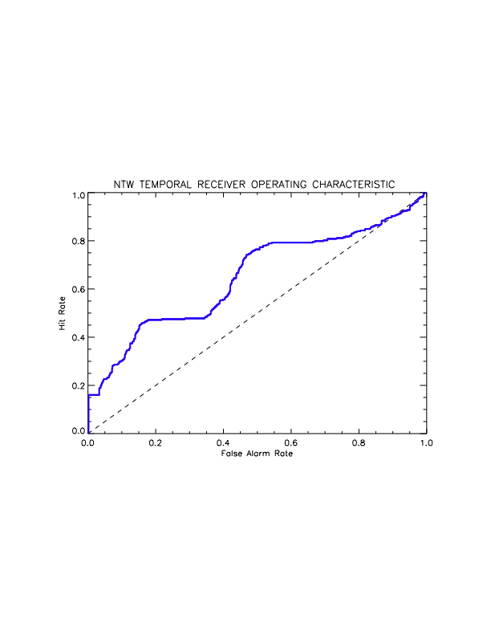
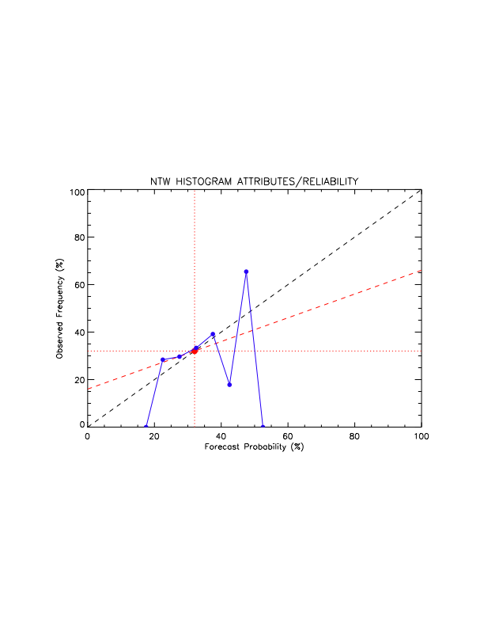
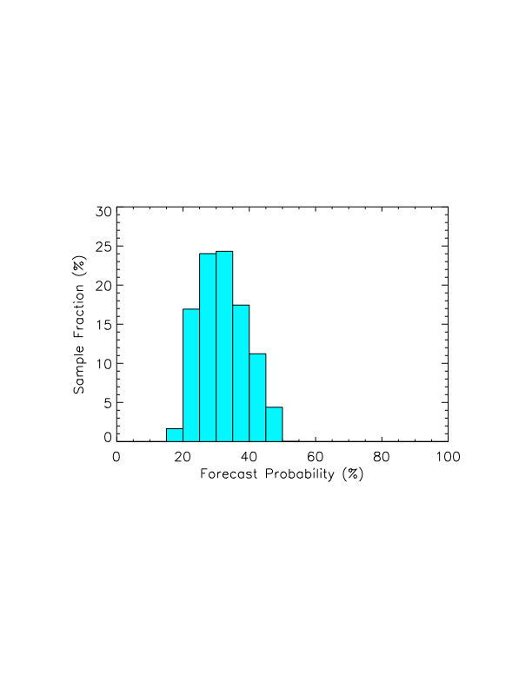
California EQ Forecast Advanced Technology
(Open Hazards Group)
Optimized 12 month California-Nevada forecast:
Probabilities (%) vs. Time for Magnitude ≥ 6
Optimal forecasts via backtesting, using
common validation and verification testing procedures.
Forecast Date: 2012/03/15
Scatter Plot
1980-present
Observed Frequency vs. Computed Probability
Hit Rate
Temporal Receiver Operating Characteristic
1980-present
False Alarm Rate

Slide 29
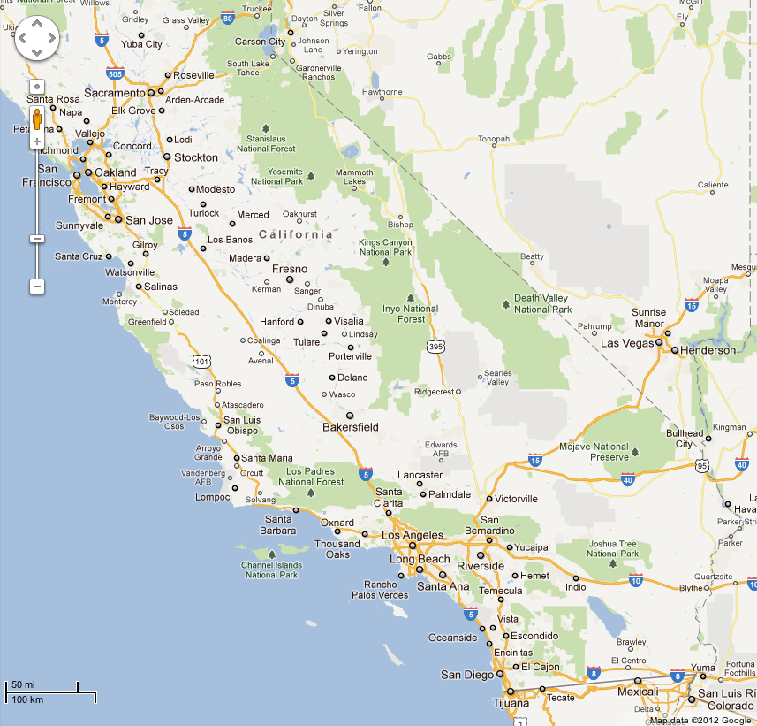
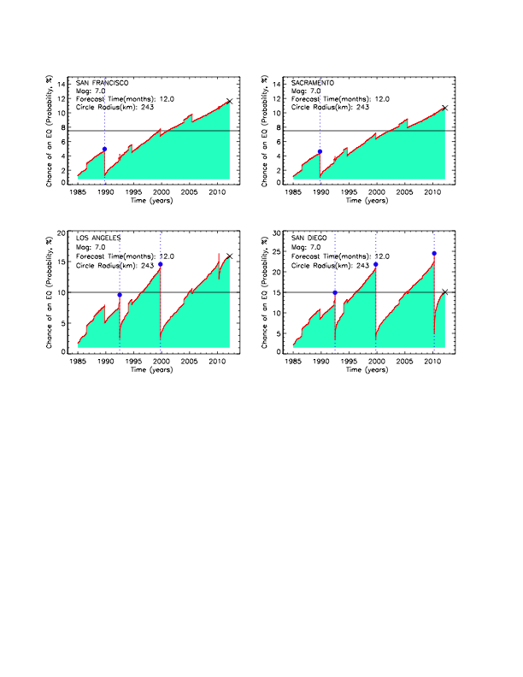
California Four Cities Forecast
Probability of M ≥ 7, Distance ≤ 150 Miles, Within 12 Months
11%
12%
15%
16%

Slide 30
In Summary
Earthquake risk changes in real time
Tohoku earthquake may have been triggered by a M7.4 event 600 km away
Risk of an M7 earthquake in California is largest in southern California

